Slide 1

Using MATLAB to Measure the Diameter of an Object within an Image
Group No. 07 ➔ F16CS06 | 22 | 38 | 58

Slide 2
Contents
Introduction
Objective
Working
Tools
Methodology
Result

Slide 3
Introduction
“MATLAB is a high-level language and interactive environment for computer computation, visualization, and programming. Image Processing Toolbox is an application available for use in MATLAB, which provides a comprehensive set of reference-standard algorithms, functions, and apps for image processing, analysis, visualization, and algorithm development.” Using these tools provides a fast and convenient way to process and analyze images without the need for advanced knowledge of a complex coding language.

Slide 4
Objective
Through this application note you will be able to write a MATLAB script file to import an image, segment the image in order to isolate the desired object from its background and then use the MATLAB functions that come with the Image Processing Toolbox to determine the objects diameter. It is assumed in this Application Note that the reader has a basic knowledge of MATLAB.

Slide 5
Working
Segment Image
Remove Noise
Measuring Image
Image Import
Resultant Image

Slide 6
Tools
MATLAB 2018a
Image Processing Toolbox
Windows XP or better Or Mac OS X Lion or better
Intel or AMD x86 processor 4 GB or better disk space
2048 MB RAM at least recommended
Hardware accelerated graphics card supporting OpenGL 3.3 and1 GB GPU memory recommended

Slide 7
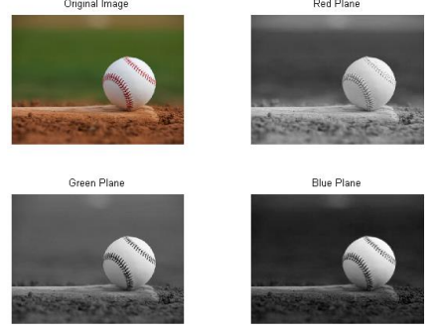
Methodology

Slide 8
Methodology:

Slide 9
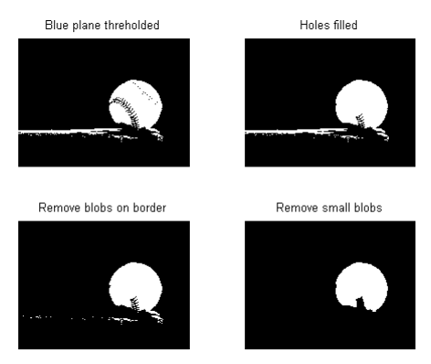
Methodology:

Slide 10
Methodology:

Slide 11
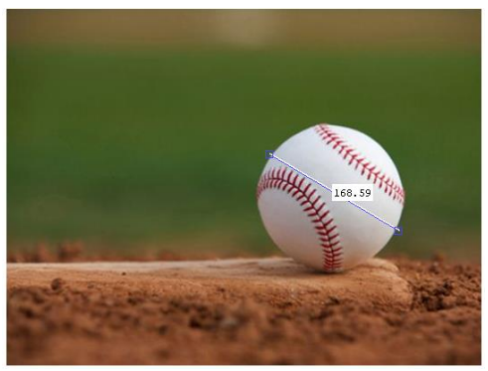
Result:
The diameter will be displayed in the command window

